Slide 1

Java PushbackInputStream class
A PushbackInputStream adds functionality to another input stream, namely the ability to "push back" or "unread" one byte
The PushbackInputStream is intended to be used when you parse data from an InputStream. Sometimes you need to read ahead a few bytes to see what is coming, before you can determine how to interpret the current byte. The PushbackInputStream allows you to do that. Well, actually it allows you to push the read bytes back into the stream. These bytes will then be read again the next time you call read().
PrintStream
Pushback
InputStream(i.e. FileInputStream)
PushbackInputStream
Java Application
Read
Read

Slide 2
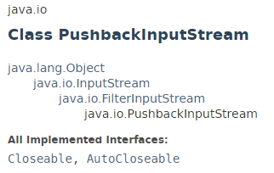
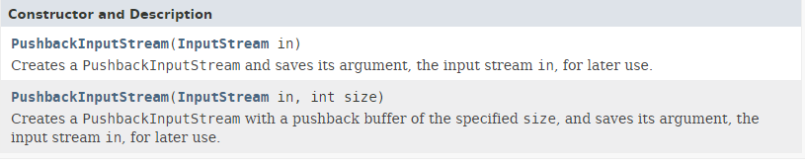
Java PushbackInputStream class

Slide 3
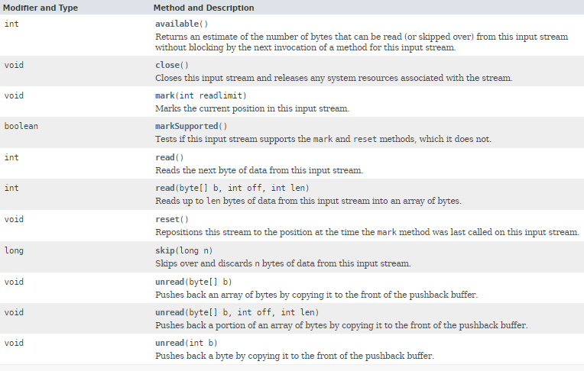
Java PushbackInputStream class

Slide 4
Java PushbackInputStream class

